Slide 1




Artificial Neural Networks (Using R))

Slide 2
Contents
Case Study Background
Neural Network in R
Visualizing Neural Networks
ROC Curve

Slide 3
Case Study – Predicting Loan Defaulters
Background
Objective
Available Information
The bank possesses demographic and transactional data of its loan customers. If the bank has a robust model to predict defaulters it can undertake better resource allocation.
To predict whether the customer applying for the loan will be a defaulter
Defaulter (=1 if defaulter, 0 otherwise) is the dependent variable
Age group, Years at current address, Years at current employer, Debt to Income Ratio, Credit Card Debts, Other Debts are the independent variables
Sample size is 700

Slide 4
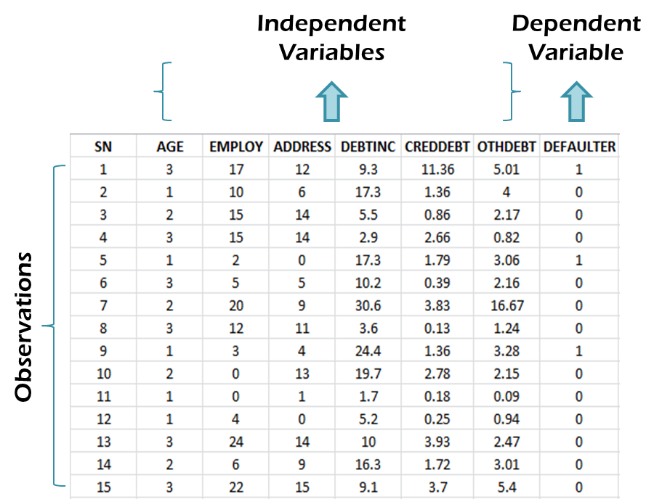
Neural Network in R… Data Snapshot
BANK LOAN
Column | Description | Type | Measurement | Possible Values
SN | Serial Number | - | - | -
AGE | Age Groups | Integer | 1(<28 years),2(28-40 years),3(>40 years) | 3
EMPLOY | Number of years customer working at current employer | Integer | - | Positive value
ADDRESS | Number of years customer staying at current address | Integer | - | Positive value
DEBTINC | Debt to Income Ratio | Continuous | - | Positive value
CREDDEBT | Credit to Debit Ratio | Continuous | - | Positive value
OTHDEBT | Other Debt | Continuous | - | Positive value
DEFAULTER | Whether customer defaulted on loan | Integer | 1(Defaulter), 0(Non-Defaulter) | 2

Slide 5
Data Pre-Processing
Since AGE is categorical variable, we will create dummy variables before proceeding to neural network model.
To set up a neural network to a dataset it is very important that we ensure a proper scaling of data. The scaling of data is essential because otherwise, a variable may have a large impact on the prediction variable only because of its scale.
The common techniques to scale data are min-max normalization and Z-score normalization
The min-max normalization transforms the data into a common range, thus removing the scaling effect from all the variables. Here we are using min-max normalization for scaling data.

Slide 6
Neural Network in R - Classifying Loan Defaulters…
bankloan<-read.csv("BANK LOAN.csv") library(fastDummies) bankloan <- dummy_cols(bankloan,select_columns = "AGE",remove_first_dummy = T) normalize <- function(x) { return ((x - min(x)) / (max(x) - min(x))) } bankloan$EMPLOY<-normalize(bankloan$EMPLOY) bankloan$ADDRESS<-normalize(bankloan$ADDRESS) bankloan$DEBTINC<-normalize(bankloan$DEBTINC) bankloan$CREDDEBT<-normalize(bankloan$CREDDEBT) bankloan$OTHDEBT<-normalize(bankloan$OTHDEBT)

Slide 7
Neural Network in R - Classifying Loan Defaulters…
library(neuralnet) set.seed(09092022) nn_bank <- neuralnet(DEFAULTER~AGE_2+AGE_3+EMPLOY+ADDRESS+ DEBTINC+CREDDEBT+OTHDEBT, data=bankloan, hidden=3,err.fct="ce",linear.output=FALSE) out_bank <- cbind(nn_bank$covariate,nn_bank$net.result[[1]]) dimnames(out_bank) <- list(NULL, c("AGE_2","AGE_3", "EMPLOY","ADDRESS","DEBTINC", "CREDDEBT","OTHDEBT","nn-output")) head(out_bank)
neuralnet() takes formula interface. Here, DEFAULTER is the variable of interest.
hidden= Number of hidden neurons in each layer.
err.fct= a differentiable function that is used for the calculation of the error. ‘ce’ stands for cross entropy.
linear.output= FALSE ensures that the output is mapped by the activation function to the interval [0, 1].
By default the command uses Resilient Backpropagation with Weight Backtracking

Slide 8
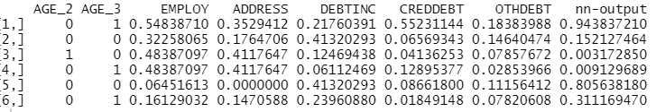
Neural Network in R - Classifying Loan Defaulters…
# Output

Slide 9
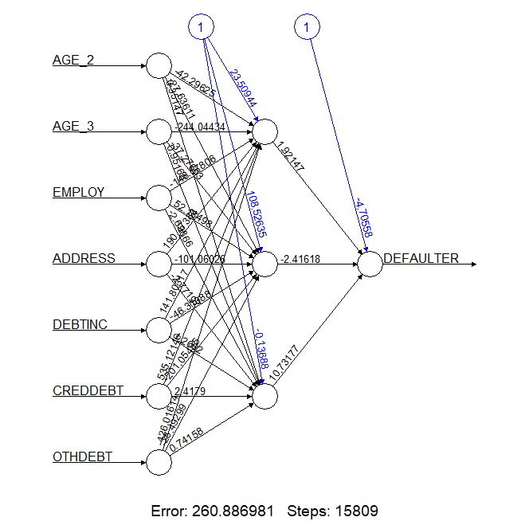
Neural Network in R - Classifying Loan Defaulters…
plot(nn_bank)
# Output

Slide 10
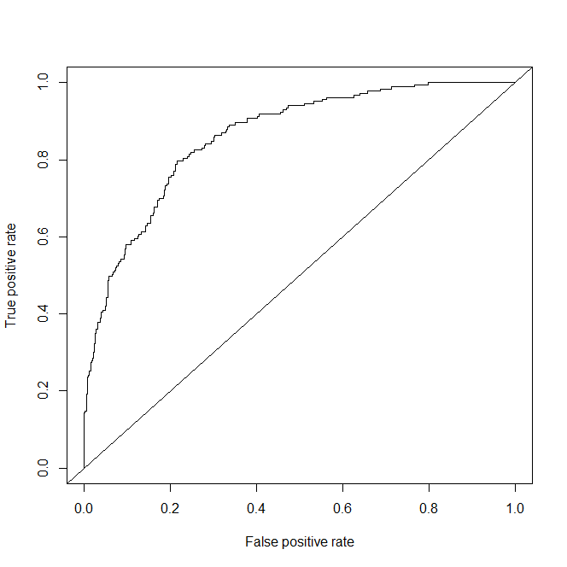
Neural Network in R - Classifying Loan Defaulters…
# ROC Curve for NN output
library(ROCR) # Convert 'out' to dataframe outdf<-as.data.frame(out_bank) pred<-prediction(outdf$`nn-output`,bankloan$DEFAULTER) perf<-performance(pred,"tpr","fpr") plot(perf) abline(0,1) auc<-performance(pred,"auc") auc@y.values [1] 0.8606505

Slide 11
More About ANN Work
Applications in Artificial Intelligence - Handwriting or Face Recognition, Voice Analysis
The “building blocks” of neural networks are the neurons. In technical systems, we also refer to them as units or nodes.
Basically, each neuron receives input from many other neurons, changes its internal state (activation) based on the current input, sends one output signal to many other neurons, possibly including its input neurons (recurrent network)
Information is transmitted as a series of electric impulses, so-called spikes.
The frequency and phase of these spikes encodes the information.
In biological systems, one neuron can be connected to as many as 10,000 other neurons.
Neurons of similar functionality are usually organized in separate areas (or layers).
Often, there is a hierarchy of interconnected layers with the lowest layer receiving sensory input and neurons in higher layers computing more complex functions.

Slide 12
Quick Recap
Neural Networks in R
Package “neuralnet" has neuralnet() that trains a neural network model

Slide 13
THANK YOU!

